Slide 1
MAL1, Session 7
Logistic Regression
Support Vector Machines

Slide 2
Logistic Regression
A classification model (not regression, despite the name)
Like decision trees
Divides the problem space with hyperplanes
Unlike decision trees
Only one hyperplane
The hyperplane can be all directions
Logistic regression can model uncertainty
Decision trees make "hard" decisions, logistic regression makes "soft" decisions
Both work with linearly separable data

Slide 3
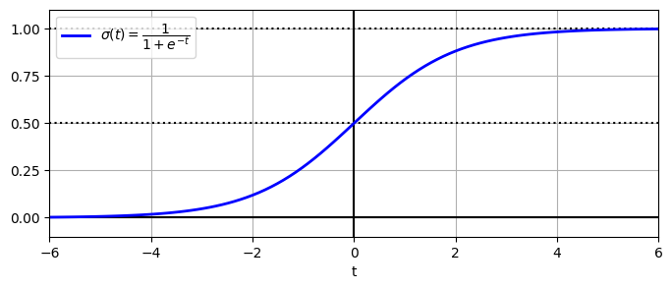
The sigmoid (or logistic) function

Slide 4
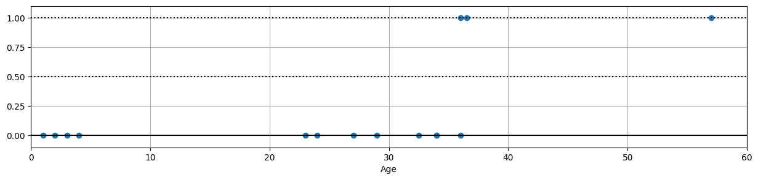
Titanic deaths by age (2nd class only)

Slide 5
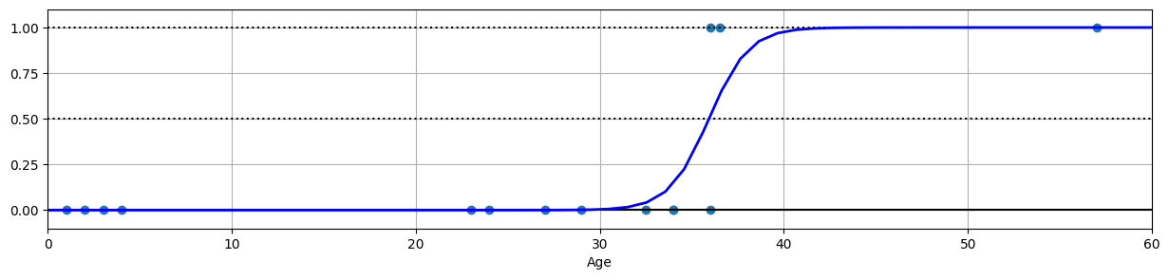
Probability of dying by age (2nd class)

Slide 6
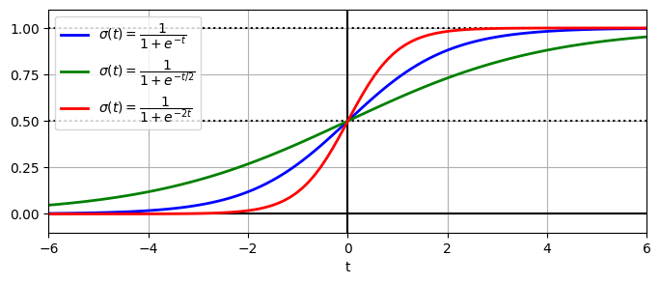
Impact of coefficients

Slide 7
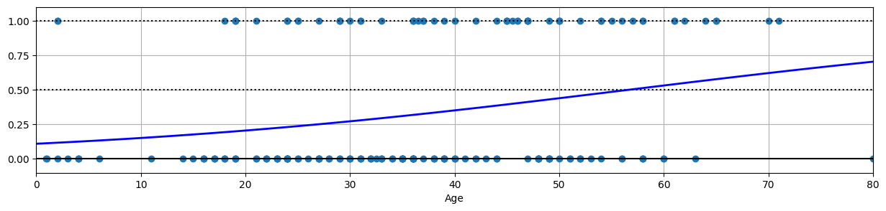
Probability of dying by age (all classes)

Slide 8
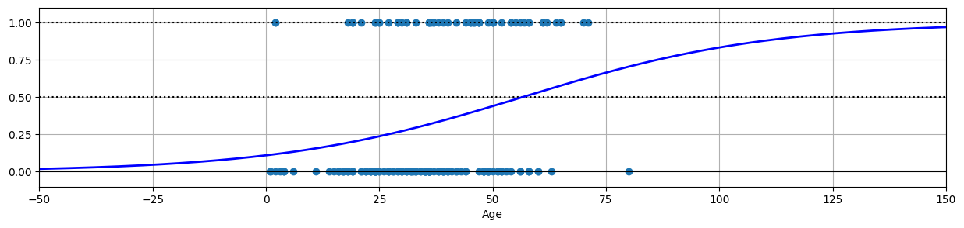
Probability of dying by age (all classes)

Slide 9

Logistic regression
Cost
Goal: minimize
Gradient descent or (variations of) Newton iteration
Both use the derivative

Slide 10
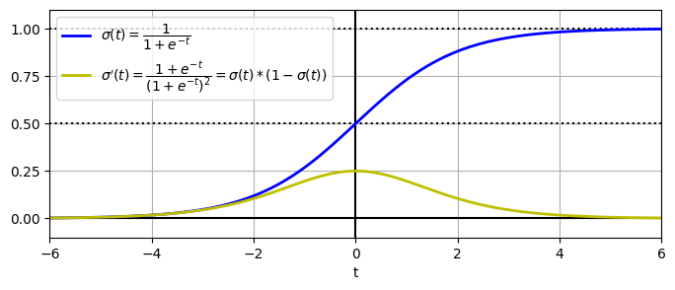
The sigmoid and it's derivative

Slide 11

Lasso (L1) and Ridge (L2)
Also work for logistic regression
Add penalty item to cost:
Ridge:
Lasso:
Combats overfitting by driving redundant coefficients low (Ridge) or down to zero (Lasso)

Slide 12
Softmax (multinomial) Regression
Binary regression:
Softmax regression for multiple categories, k = 1, 2, 3, ..., K

Slide 13
Logistic regression hyperparameters
C = λ-1
Lower C (bigger l) requires
Smaller coefficients
Flatter, "softer" curve
Too low C: underfitting
Higher C allows (but doesn't require)
Higher coefficients
Steeper, "harder" curve
Too high C: overfitting
penalty: Choose between 'l1' (Lasso) and 'l2' (Ridge) or 'elasticnet'

Slide 14
Examples
logistic regression.ipynb

Slide 15
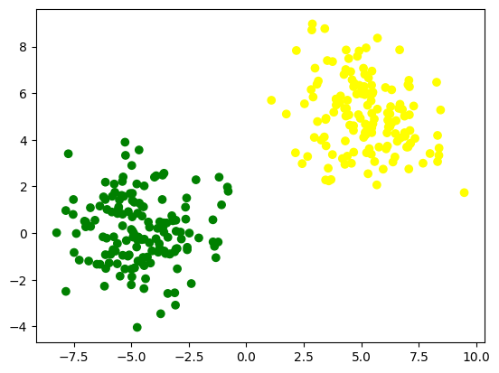
Choosing the linear separator

Slide 16
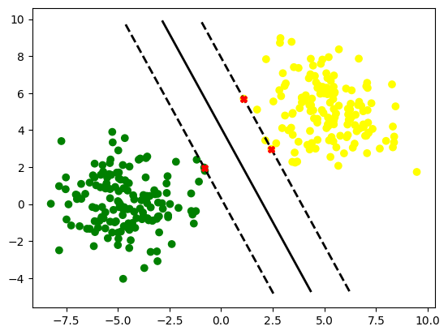
Support Vector Machine Model

Slide 17
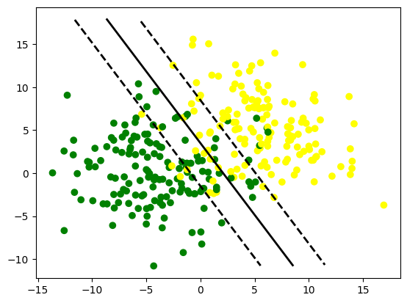


Soft margin SVM
Usually data isn't clean enough to be fully separable
Support Vector Machines allow for a slack variable, ζ
The hyperparameter C suppresses the slack, Lasso style
High C => low slack
Too high C creates overfitting, too low C creates underfitting

Slide 18
Non-binary classification
One-vs-rest (ovr)
ovr training
Take a category and solve it as a binary classification ("is it green or not")
Do this for all values in the category set
Save all k SVMs
ovr prediction
Run all SVMs and return the one with the best score
One-vs-one (ovo)
ovo training
Take two categories and run them against each other ("is it green or yellow"). Disregard samples that are neither.
Do this for all combinations of values in the category set
Save all k(k-1)/2 SVMs
ovo prediction
Run all SVMs and return the one with the most "wins"

Slide 19
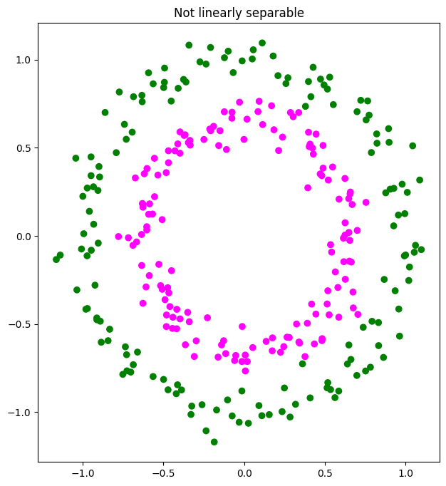
When data is not linearly separable
Ideas?

Slide 20
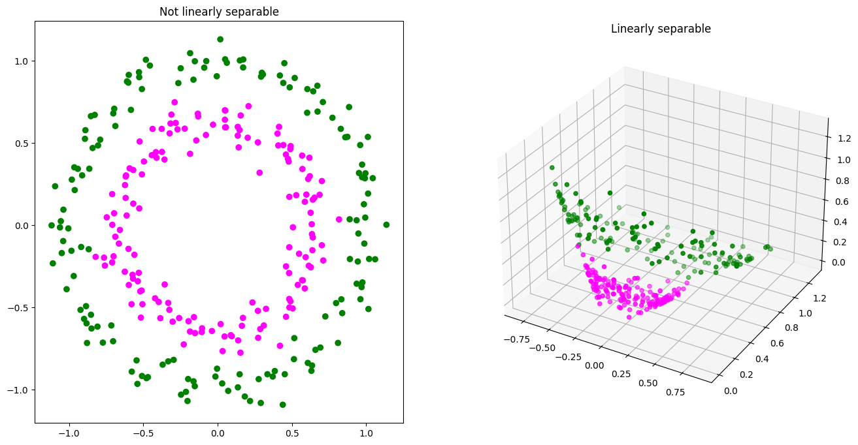
Higher dimensions

Slide 21
The kernel trick
We could make these transformations first, but...
... adding too many dimensions (=features) slows down the algorithm
The kernel trick:
Deep inside the (complex) math for SVM solution we find this: X_{i}^{T} X_{j}
This is known as the linear kernel
We can swap the linear kernel for another function K(X_{i}, X_{j})
K is the kernel
Not all functions are suitable as kernels - use the built-ins

Slide 22
The RBF kernel
The (Gaussian) Radial Basis Function kernel is the default kernel in sklearn
This corresponds to mapping the problem space to an infinite-dimensional space
Consequently, the RBF kernel is very flexible and useful
It is, unfortunately, slow

Slide 23
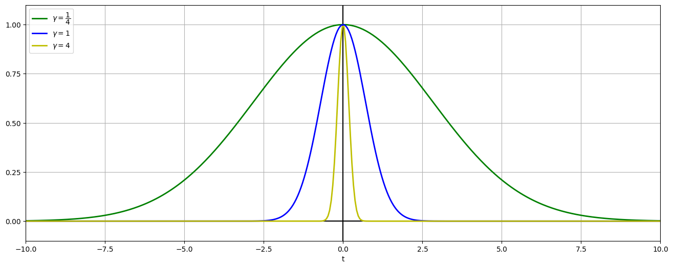
Effect of gamma

Slide 24
Hyperparameters
C is the same as for the linear kernel
gamma
The decision boundaries are no longer straight lines but curves
High gamma makes the probability function steeper
More importantly: High gamma makes the decision boundaries curvier
Too high C and gamma can put every sample in it's own little region (overfitting)

Slide 25
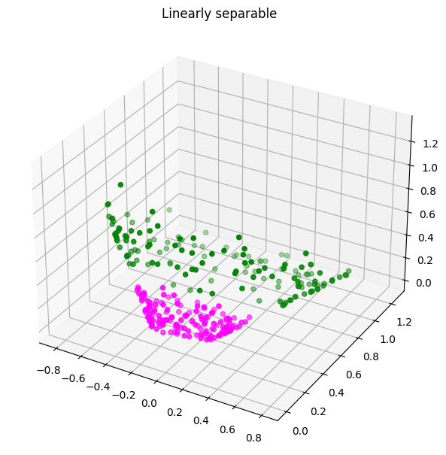

The poly kernel
This corresponds to mapping the problem space to a higher-dimensional space (right)
Faster than RBF, slower than linear
Not as versatile as RBF, but more than linear

Slide 26
Dimensions
r = 0
r ≠ 0*
Features | d = 2 | d = 3 | d = 4
k = 1 | 1 | 1 | 1
k = 2 | 3 | 4 | 5
k = 3 | 6 | 10 | 15
k = 4 | 10 | 20 | 35
k = 5 | 15 | 35 | 70
Features | d = 2 | d = 3 | d = 4
k = 1 | 3 | 4 | 5
k = 2 | 6 | 10 | 15
k = 3 | 10 | 20 | 35
k = 4 | 15 | 35 | 70
k = 5 | 21 | 56 | 126
*One of the dimensions is constant r²

Slide 27
Hyperparameters
C still makes the margin harder
gamma still makes the probability curve steeper
degree makes the model more complex (higher dimensionality)
especially in conjunction with coef0
Note: There is a qualitative difference between even and odd degrees
coef0 = r
coef0 makes the model more complex when different from 0
High coef0 gives more weight to the lower-degree terms of polynomial
If you find yourselves fiddling too much with coef0 it might be a sign you should have used RBF

Slide 28
Overall
Both methods work well on high-dimensional data
Both methods are vulnerable to scaling - might require preprocessing
Logistic Regression is fast, but requires linear separability
Support Vector Machines are slow, but powerful
Support Vector Machines requires hyperparameter tuning - beware of overfitting
Always try Logistic Regression first. If for no other reason, then to explore the problem space

